Slide 1
Computers and the Environment
The negative impact of innovation in technology and how do we minimize this impact?

Slide 2
Introduction
Technology innovation is ongoing and affects our lives in ways that are difficult to predict.
Innovation, however, can have some unintended consequences such as:
An increase in electronic waste (e-waste) due to technology breaking/becoming obsolete
An increase in energy consumption
An increased use of toxic materials
Increased pollution from manufacturing
As we become aware of the dangers new technology pose, we can create solutions to minimize the environmental impact

Slide 3
Example: When to update?
Consider the following scenario:
You have a cell phone only 2 years old
It functions fairly well
It seems a little slower than when you first got it
The battery seems to drain a little faster than you remember
A popular cell phone manufacturer has just released its latest cell phone model
Do you upgrade?

Slide 4
Current Global Concerns
Tremendous amounts of e-waste is being generated
Excessive power consumption creates pollution from fossil-fueled power plants
Older technology wasn’t designed to be environmentally friendly and persists for decades
E-waste may contain toxic materials that can lead to environmental contamination if not properly disposed of

Slide 5
Possible Solutions
Power Consumption
Make devices shut off/hibernate when not in use
Seek ways to use less power to operate electronics
Resource preservation
Use renewable materials whenever possible
Make electronic devices as recyclable as possible
Incorporate recycled materials into electronic goods
Minimize/Eliminate toxic materials in electronic goods

Slide 6
Possible Solutions
Education
Promote awareness of the impact technology has on the environment
Identify locations where you can safely dispose of e-waste
Continue to innovate technology that is designed to have a minimal impact on the environment
Seek nontoxic alternatives to existing toxic components
Design technology that is all/mostly recyclable

Slide 7
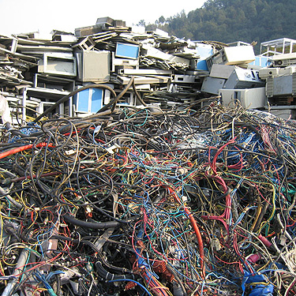
Guiya, China
Basal Action Network Video

